Slide 1
Positive Psychology:
The Science of Humor
Shawn Achor
Harvard University
Spring 2008

Slide 2
Working Definition
Humor is a way of mindfully perceiving the world, analogous to optimism, where an individual heightens awareness of potentials in a situation.

Slide 3
Outline
I. Psychology of humor
II. Mental and Physical Benefits
III. Positive Social Benefits
IIII. Pragmatic steps
IIIII. The greatest power of humor

Slide 4
What just happened?
"rhythmic, vocalized, expiratory and involuntary actions"
15 facial muscles contract
  Zygomatic major muscle raises lip
Epiglottis half-closes the larynx
Blood pressure lowered
Increase in vascular blood flow
Flexed abdominal, respiratory, facial, leg, and back muscles.

Slide 5
How We Study Changes Us
97 to 3 ratio of negative to humor research
  “Depression” 125,089 articles
  “Humor” 4,943
  “Steven Colbert” (no results found)
Medical School Syndrome

Slide 6
Why talk about humor?
Definitional problems
Dead Frog Problem
Genetics vs. Environment

Slide 7
The Psychology of Funny
Freud: Humor as “psychological release”
  Jokes and Their Relationship to the Unconscious
“Social acceptable envelope of id desires”

Slide 8
Henri Bergson
Humor as social “corrective”
The Dale Sturtevant Theory

Slide 9

Dale Sturtevant

Slide 10
Achor: Humor as mindful lens
Social rule breaking
Humor = shift in evaluative stance
  Counterfactuals
Positive spin: Alpha vs Beta Press
    Alpha press- objective constraints of reality
    Beta press– subjective construal of reality
Mindfulness of potentialities

Slide 11

The Tetris Effect
Humor as cognitive afterimage (Achor, 2007)

Slide 12
Humor as transformative lens
Transcending the status quo (Berger)
Relationship to Peak Experiences (Maslow)
  Momentarily take on self-actualization
  Ordinary becomes extraordinary (the Office)

Slide 13

Ordinary Transformed

Slide 14


Slide 15
Part III: The Physical and Mental Benefits of Humor

Slide 16
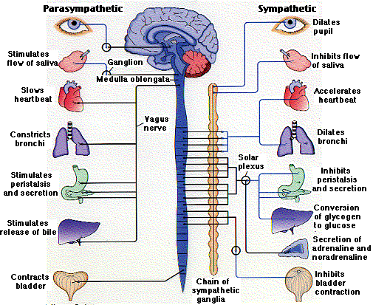
Sympathetic Nervous System

Slide 17

The Soprano Effect (Achor, 2006)

Slide 18
The Biology of Laughter
Laughter as medicine and exercise
Increases in
  T-cells (immune system)
  Gamma-interferon (disease fighting protein)
  B-cells (makes antibodies)
Laughter decreases serum cortisol (Sultanoff)

Slide 19
The Mental and Physical Benefits
Even small dose increases immune system
    Bronchial asthma (Kamata)
Humor increases pain tolerance
    Ice bucket experiment (Zweyer)
Lowers blood sugar for Type 2 Diabetes (Hayashi)
Decreases stress/ increases remission rates
    Testicular Cancer (Chapple and Zieland)

Slide 20

Model students?
Average # of romantic relationships < 1
  Average number of sexual partners 0-.5
24% are unaware if they are currently in a romantic relationship

Slide 21
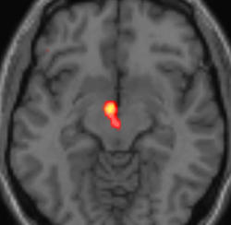
Positive Social Effects:
Mirror Neurons and Condoms
Attraction and bondage (Fraley)
Dating: Desirability in mates
  Signal of cognitive fitness
  Differences between men and women (Bressler)
  Flirting at a bar
Negotiations and Marriage
  Gottman

Slide 22
Humor as Therapy
Humor and Journaling (Pennebaker)
Cuddle parties, laughing groups in India
Transforming trauma and bad days

Slide 23
6 Ways to Increase Humor
1. Journal funny stories unique to you
2. Watch funny people
3. TQP—Two question process
A. Why am I so funny?
  B. And why don’t others recognize this?
  Builds self-esteem
4. The permission to be subhuman
5. Variety, breaking pattern
6. Tetris Effect

Slide 24
The greatest power of humor
Jon Stewart post 9/11
The suffering Onion

Slide 25

Jon Stewart

Slide 26

Slow Transformation

Slide 27


Slide 28
Conclusion
Humor is a lens like optimism
Demands a mindfulness to potentialities
Increased health, increased sociability, and decreased stress
Humor as therapeutic reorientation

Slide 29

Shining with Humor Lens

